Slide 1
Moodify: Emotion-Based Music Classification and Recommendation System
Leveraging Emotional Features for Better Music Recommendations
By
Olawuwo Toheeb Adedapo
April 2nd 2024

Slide 2
Introduction
The main idea of Moodify project is to classify songs not only based on their lyrical and musical features, but also incorporating emotions, in order to provide users with more successful recommendation outputs. Moodify aims to categorize songs into four main emotions and utilize the similarities in musical features within these categories to offer users more effective recommendations, weighting them with emotions.

Slide 3

Objectives of the Project
To develop an accurate model that classify songs into four main emotions using both lyrical and musical features.
Improve the accuracy of music recommendations by understanding the emotional impact of songs..
Enhance user satisfaction by providing music recommendations that align with users' emotional states.

Slide 4
Dataset Description
Dataset Overview
Target Variable
The Moodify dataset consists of nearly 278,000 songs from Spotify, each annotated with emotional labels. This extensive dataset includes features like danceability, energy, loudness, and valence, which are crucial for understanding the emotional context of each song.
Source:
This dataset was gotteb from kaggle : https://www.kaggle.com/datasets/abdullahorzan/moodify-dataset
Labels: {'sad': 0, 'happy': 1, 'energetic': 2, 'calm': 3}

Slide 5
Exploratory Data Analysis (EDA)
Data Cleaning
Data Visualization
During our data cleaning I dropped some unwanted columns( 'Unnamed: 0.1', 'Unnamed: 0', 'uri' ), we checked for null values and remove duplicates data from the dataset. Duplicated values were removed through duplicated method.There is no missing values in the dataset.
Through exploratory data analysis, we gained insights into the dataset's structure and identified key features impacting emotional classification. Visualizations revealed correlations between energy, danceability, and specific emotional labels, providing a foundation for our predictive modeling.

Slide 6
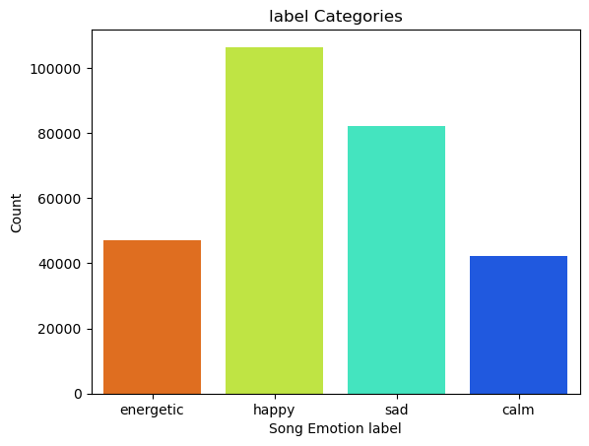
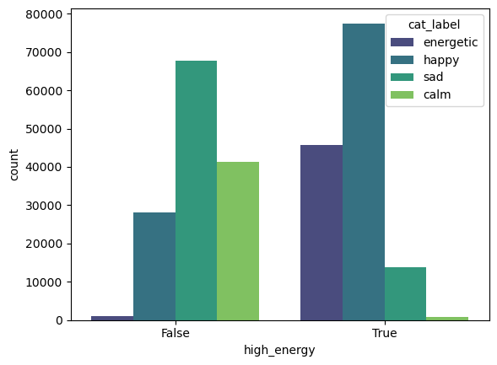
Data Visualization
Distribution of song across emotional label
Emotional label Distribution with High Energy

Slide 7
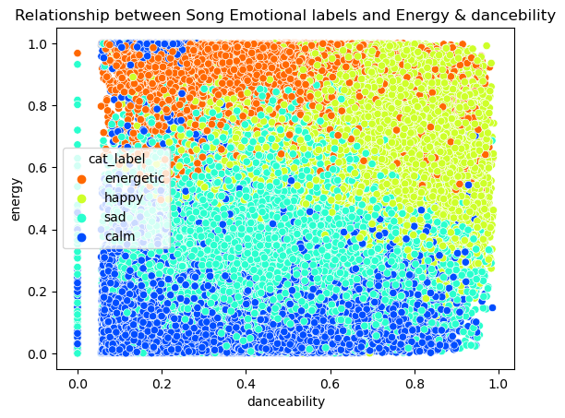
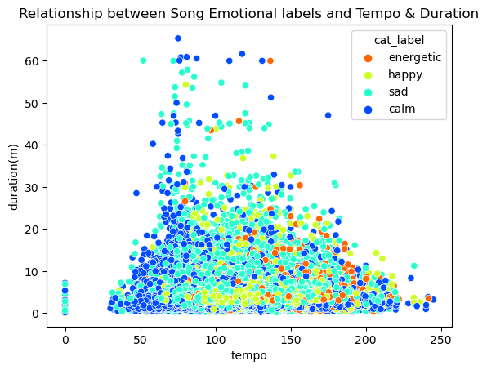
Data Visualization Using Scatterplot
Emotional label with Energy and Danceability
Emotional label with Tempo and Duration

Slide 8
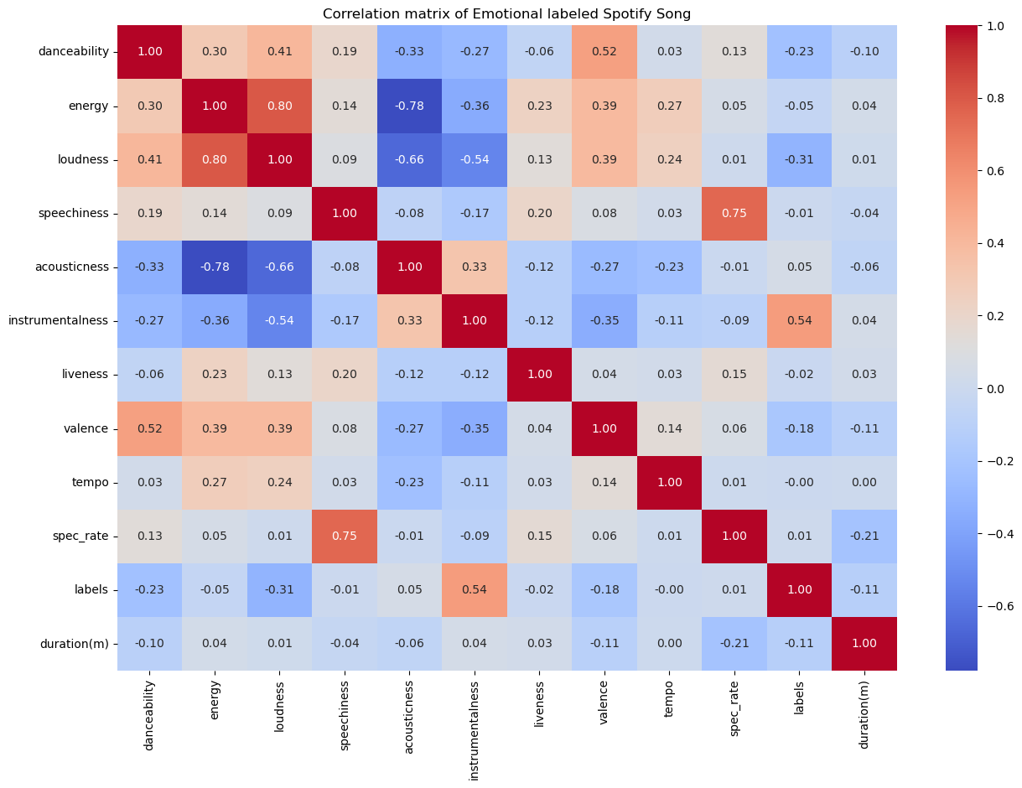
Data Visualization (Correlation between the features)

Slide 9
Insight from the Analysis
The largest percentage of the data contain happy label.
Energetic songs have moderate dancebility, high energy, low duration and high tempo
Sad songs have low dancebility, low energy, moderate tempo and low duration
Happy songs have high energy, high dancebility, low duration and moderate tempo
Most of the Calm songs have high energy, high danceability, high duration and moderate tempo
There is a high correlation between loudness and energy
Duration has little or no correlation with other features

Slide 10
Feature Engineering
Feature engineering allow me to create novel metrics that better capture the emotional essence of songs. By analyzing feature importance, we identified key attributes contributing to accurate emotional classification, ensuring our model is both efficient and effective
Feature Creation
1. Duration was categorized into short, medium and long time duration
2. Loudness was categorized into low, medium and high volume.
3. Energy was categorized into high or low.
Feature Selection
Energy, loudness, duration and tempo were majorly selected for to provide more insight on the analysis and create more understanding and contribute to accuracy of emotion label classification. .

Slide 11
Model Selection and Methodology
Multiple machine learning models ( catboost, xgboost, LGBMClassifier, Randomforest, Decisiontree and LogisticRegression) were tested on this dataset to predict the features that is important in songs label classification.
Model Selection
Catboost model was selected among other models because of its superior performance in handling large datasets and its ability to capture complex patterns within the data and its high accuracy and precision.

Slide 12
Results
Model Performance
The Catboost model demonstrated impressive accuracy in classifying songs into emotional categories, achieving a precision of 97% across all labels.
The confusion matrix provides further insights into the model's classification strengths and areas for improvement.
Feature Importance
The features that are important for classification according to the model results are: energy, instrumentalness, danceability, and acousticness

Slide 13
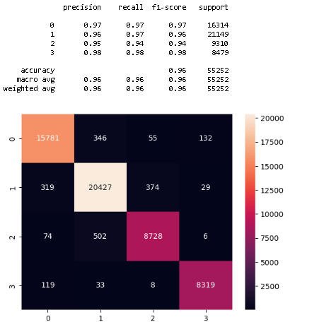
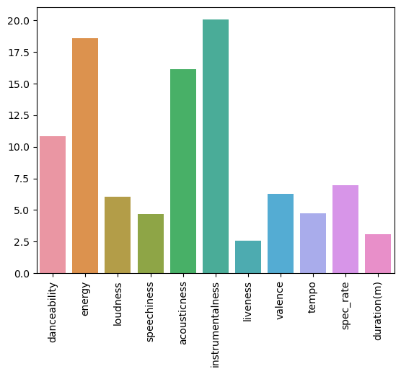
Result Diagram
Confusion Metrics
Feature Importance

Slide 14
Key Findings and Insights
Key factors influencing songs emotion prediction include energy, instrumentalness and danceability. Interestingly, duration do not appear to have any correlation with other features and classification of emotion.

Slide 15

Recommendations and Applications
Moodify model significant application in music industry for determining the type of music want by people
This model can also be recommended to person suffering from mental health as a tranquilizer.

Slide 16
Conclusion
This project aim to classify songs into four main emotions using both lyrical and musical feature based on emotional attributes, offering a new dimension in music recommendations. The results shows that factors influencing emotion prediction include energy, instrumentalness and danceability.
Future work may explore incorporating user feedback to refine recommendations further, ensuring continued alignment with evolving emotional preferences.

Slide 17
Data Pipeline
Data pipeline was built for easy automation and application of songs for recommendation without the need of conducting new analysis.

Slide 18
Thank You

